Slide 1


Chapter 13
Randomized
Algorithms
Slides by Kevin Wayne.
Copyright @ 2005 Pearson-Addison Wesley.
All rights reserved.

Slide 2
Randomization
Algorithmic design patterns.
  Greedy.
  Divide-and-conquer.
  Dynamic programming.
  Network flow.
  Approximation
  Randomization.
Randomization. Allow fair coin flip in unit time.
Why randomize? Can lead to simplest, fastest, or only known algorithm for a particular problem.
Ex. Symmetry breaking protocols, graph algorithms, quicksort, hashing, load balancing, Monte Carlo integration, cryptography.
in practice, access to a pseudo-random number generator
Notes:
Allow algorithm to make random decisions as it processes the input.
Efficient randomized algorithms only need to yield the correct answer with high probability, whereas efficient deterministic algorithms always yield the correct answer.

Slide 3
13.1 Contention Resolution

Slide 4
Contention Resolution in a Distributed System
Contention resolution. Given n processes P₁, …, P_{n}, each competing for access to a shared database. If two or more processes access the database simultaneously, all processes are locked out. Devise protocol to ensure all processes get through on a regular basis.
Restriction. Processes can't communicate.
Challenge. Need symmetry-breaking paradigm.
P₁
P₂
.
.
.
P_{n}

Slide 5
Slotted ALOHA
Assumptions
all frames same size
time is divided into equal size slots, time to transmit 1 frame
nodes start to transmit frames only at beginning of slots
nodes are synchronized
if 2 or more nodes transmit in slot, all nodes detect collision
Operation
when node obtains fresh frame, it transmits in next slot
no collision, node can send new frame in next slot
if collision, node retransmits frame in each subsequent slot with prob. p until success
5: DataLink Layer
5-<number>
Notes:
ALOHA originally stood for Additive Links On-line Hawaii Area. ALOHAnet, also known as the ALOHA System,[1][2] or simply ALOHA, was a pioneering computer networking system developed at the University of Hawaii.
The Slotted ALOHA requires that time be segmented into slots of a fixed length exactly equal to the packet transmission time. Every packet transmitted must fit into one of these slots by beginning and ending in precise synchronisation with the slot segments.
Pure ALOHA:
If you have data to send, send the data
If, while you are transmitting data, you receive any data from another station, there has been a message collision. All transmitting stations will need to try resending "later".
Used for LAN and internet

Slide 6
Slotted ALOHA
node 1
1
1
1
1
node 2
2
2
2
node 3
3
3
3
C
E
C
S
E
C
E
S
S
Pros:
single active node can continuously transmit at full rate of channel
highly decentralized: only slots in nodes need to be in sync
simple
Cons:
collisions, wasting slots
idle slots
nodes may be able to detect collision in less than time to transmit packet
clock synchronization
Link Layer
5-<number>

Slide 7
Contention Resolution: Randomized Protocol
Protocol. Each process requests access to the database at time t with probability p = 1/n.
Claim. Let S[i, t] = event that process i succeeds in accessing the database at time t. Then 1/(e ⋅ n) ≤ Pr[S(i, t)] ≤ 1/(2n).
Pf. By independence, Pr[S(i, t)] = p (1-p)^{n-1}.
  Setting p = 1/n, we have Pr[S(i, t)] = 1/n (1 - 1/n) ^{n-1}. ▪
Useful facts from calculus. As n increases from 2, the function:
  (1 - 1/n)^{n-1} converges monotonically from 1/4 up to 1/e
  (1 - 1/n)^{n-1} converges monotonically from 1/2 down to 1/e.
process i requests access
none of remaining n-1 processes request access
value that maximizes Pr[S(i, t)] (why?)
between 1/e and 1/2
Notes:
Euler’s constant e ≈ 2.71828...:
Ln e = 1
Exponential function: Representation e^{x}, inverse ln x, derivative e^{x}
Most used inequality today: 1 − x ≤ 𝑒e ^{−x} .

Slide 8


Contention Resolution: Randomized Protocol
Claim. The probability that process i fails to access the database in
en rounds is at most 1/e. After e⋅n(c ln n) rounds, the probability is at most n^{-c}.
Pf. Let F[i, t] = event that process i fails to access database in rounds 1 through t. By independence and previous claim, we have
Pr[F(i, t)] ≤ (1 - 1/(en)) ^{t}. (why?)
  Choose t = ⎡e ⋅ n⎤:
  Choose t = ⎡e ⋅ n⎤ ⎡c ln n⎤:

Slide 9
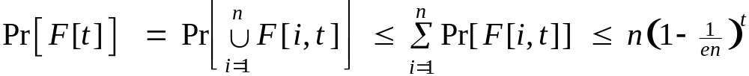
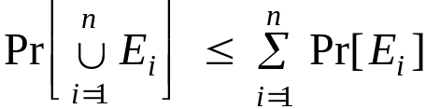
Contention Resolution: Randomized Protocol
Claim. The probability that all processes succeed within 2e ⋅ n ln n rounds is at least 1 - 1/n.
Pf. Let F[t] = event that at least one of the n processes fails to access database in any of the rounds 1 through t.
  Choosing t = 2 ⎡en⎤ ⎡c ln n⎤ yields Pr[F[t]] ≤ n · n⁻² = 1/n. ▪
Union bound. Given events E₁, …, E_{n},
union bound
previous slide

Slide 10
13.2 Global Minimum Cut
A*
B*
F*

Slide 11
Global Minimum Cut
Global min cut. Given a connected, undirected graph G = (V, E) find a cut (A, B) of minimum cardinality.
Applications. Partitioning items in a database, identify clusters of related documents, network reliability, network design, circuit design, TSP solvers.
Network flow solution.
  Replace every edge (u, v) with two antiparallel edges (u, v) and (v, u).
  Pick some vertex s and compute min s-v cut separating s from each other vertex v ∈ V.
False intuition. Global min-cut is harder than min s-t cut.

Slide 12
Contraction Algorithm
Contraction algorithm. [Karger 1995]
  Pick an edge e = (u, v) uniformly at random.
  Contract edge e.
    replace u and v by single new super-node w
    preserve edges, updating endpoints of u and v to w
    keep parallel edges, but delete self-loops
  Repeat until graph has just two nodes v₁ and v₂.
  Return the cut (all nodes that were contracted to form v₁).
a
b
c
⇒
a
b
c
u
d
v
contract u-v
w
e
f
f

Slide 13
Contraction Algorithm
Claim. The contraction algorithm returns a min cut with prob ≥ 2/n².
Pf. Consider a global min-cut (A*, B*) of G. Let F* be edges with one endpoint in A* and the other in B*. Let k = |F*| = size of min cut.
  In first step, algorithm contracts an edge in F* probability k / |E|.
  Every node has degree ≥ k since otherwise (A*, B*) would not be min-cut. ⇒ |E| ≥ ½kn.
    If a node v degree <k, then cut({v}, V-{v}) has size < k
  Thus, algorithm contracts an edge in F* with probability ≤ 2/n.
A*
B*
F*

Slide 14
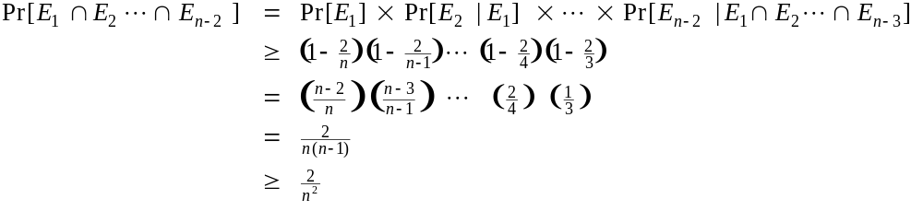
Contraction Algorithm
Claim. The contraction algorithm returns a min cut with prob ≥ 2/n².
Pf. Consider a global min-cut (A*, B*) of G. Let F* be edges with one endpoint in A* and the other in B*. Let k = |F*| = size of min cut.
  Let G' be graph after j iterations. There are n' = n-j nodes.
  Suppose no edge in F* has been contracted, then the min-cut in G' is still k.
  Since value of min-cut is k, |E'| ≥ ½kn'.
  Thus, algorithm contracts an edge in F* with probability ≤ 2/n'.
  Let E_{j} = event that an edge in F* is not contracted in iteration j.

Slide 15
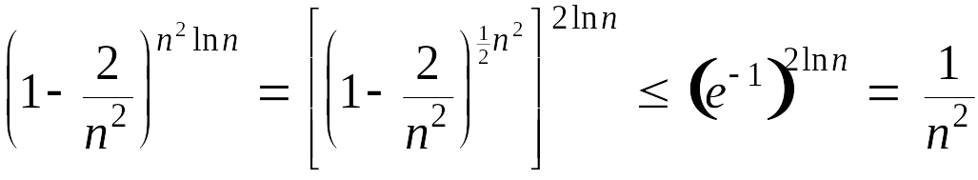
Contraction Algorithm
Amplification. To amplify the probability of success, run the contraction algorithm many times.
Claim. If we repeat the contraction algorithm n² ln n times with independent random choices, the probability of failing to find the global min-cut is at most 1/n².
Pf. By independence, the probability of failure is at most
Remark. Overall running time is slow since we perform Θ(n² log n) iterations and each takes Ω(m) time. (m is the # of edges)
(1 - 1/x)^{x} ≤ 1/e

Slide 16
13.3 Linearity of Expectation

Slide 17
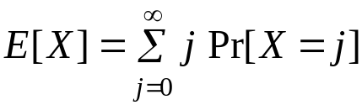
Expectation
Expectation. Given a discrete random variables X, its expectation E[X] is defined by:
Waiting for a first success. Coin is heads with probability p and tails with probability 1-p. How many independent flips X until first heads?
Geometric Distribution: The probability distribution of the number X of Bernoulli trials needed to get one success, supported on the set { 1, 2, 3, ...}
j-1 tails
1 head

Slide 18
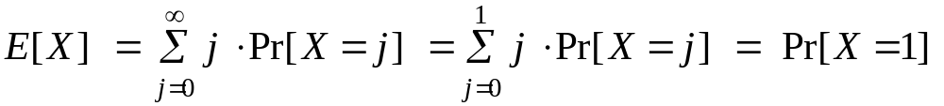
Expectation: Two Properties
Useful property. If X is a 0/1 random variable, E[X] = Pr[X = 1].
Pf.
Linearity of expectation. Given two random variables X and Y defined over the same probability space, E[X + Y] = E[X] + E[Y].
Decouples a complex calculation into simpler pieces.
not necessarily independent

Slide 19
Guessing Cards
Game. Shuffle a deck of n cards; turn them over one at a time; try to guess each card.
Memoryless guessing. No psychic abilities; can't even remember what's been turned over already. Guess a card from full deck uniformly at random.
Claim. The expected number of correct guesses is 1.
Pf. (surprisingly effortless using linearity of expectation)
  Let X_{i} = 1 if i^{th} prediction is correct and 0 otherwise.
  Let X = number of correct guesses = X₁ + … + X_{n}.
  E[X_{i}] = Pr[X_{i} = 1] = 1/n.
  E[X] = E[X₁] + … + E[X_{n}] = 1/n + … + 1/n = 1. ▪
linearity of expectation

Slide 20
Guessing Cards
Game. Shuffle a deck of n cards; turn them over one at a time; try to guess each card.
Guessing with memory. Guess a card uniformly at random from cards not yet seen.
Claim. The expected number of correct guesses is Θ(log n).
Pf.
  Let X_{i} = 1 if i^{th} prediction is correct and 0 otherwise.
  Let X = number of correct guesses = X₁ + … + X_{n}.
  E[X_{i}] = Pr[X_{i} = 1] = 1 / (n - i + 1).
  E[X] = E[X₁] + … + E[X_{n}] = 1/n + … + 1/2 + 1/1 = H(n). ▪
linearity of expectation
Harmonic number H(n):
ln(n+1) < H(n) < 1 + ln n

Slide 21
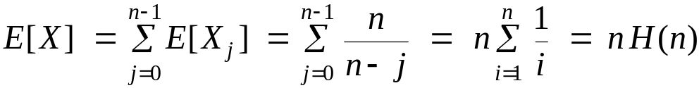
Coupon Collector
Coupon collector. Each box of cereal contains a coupon. There are n different types of coupons. Assuming all boxes are equally likely to contain each coupon, how many boxes before you have ≥ 1 coupon of each type?
Claim. The expected number of steps is Θ(n log n).
Pf.
  Phase j = time between j and j+1 distinct coupons.
  Let X_{j} = number of steps you spend in phase j.
  Let X = number of steps in total = X₀ + X₁ + … + X_{n-1}.
prob of success = (n-j)/n
⇒ expected waiting time = n/(n-j)

Slide 22
13.4 MAX 3-SAT

Slide 23
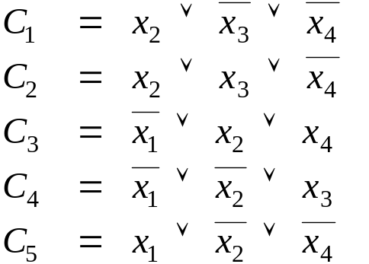
Maximum 3-Satisfiability
MAX-3SAT. Given 3-SAT formula, find a truth assignment that satisfies as many clauses as possible.
Remark. NP-hard search problem.
Simple idea. Flip a coin, and set each variable true with probability ½, independently for each variable.
exactly 3 distinct literals per clause

Slide 24
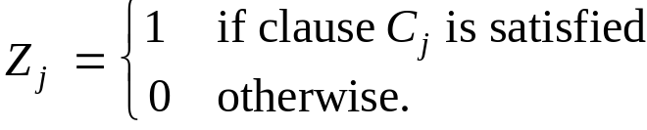
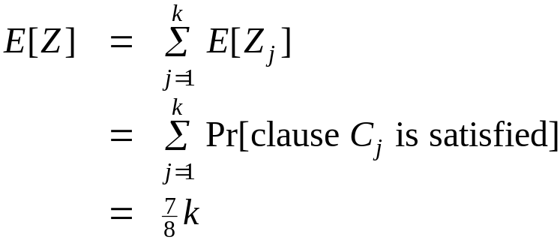
Maximum 3-Satisfiability: Analysis
Claim. Given a 3-SAT formula with k clauses, the expected number of clauses satisfied by a random assignment is 7k/8.
Pf. Consider random variable
  Let Z = # of clauses satisfied = ∑ Z_{i}
  P(a clause is not satisfied) = P( all three Boolean variables are set to false) = 1/8
linearity of expectation

Slide 25
The Probabilistic Method
Corollary. For any instance of 3-SAT, there exists a truth assignment that satisfies at least a 7/8 fraction of all clauses.
Pf. Random variable is at its expectation some of the time; is bigger than its expectation at some times. ▪
Probabilistic method. We showed the existence of a non-obvious property of 3-SAT by showing that a random construction produces it with positive probability!

Slide 26
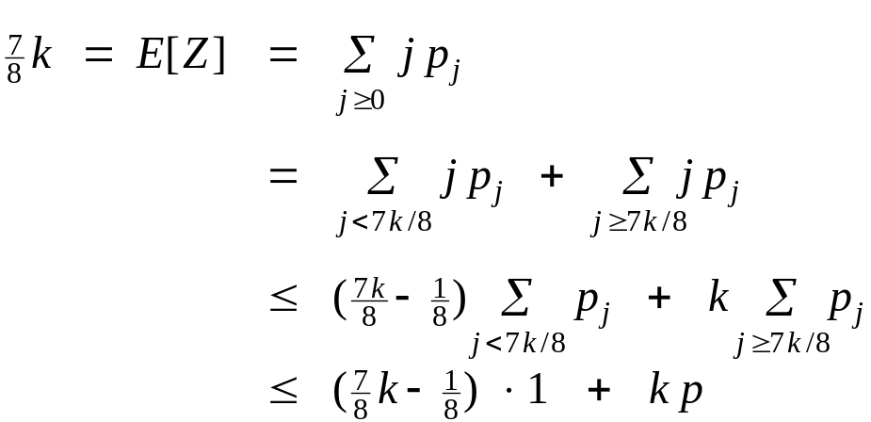
Maximum 3-Satisfiability: Analysis
Q. Can we turn this idea into a 7/8-approximation algorithm? In general, a random variable can not always be below its mean.
Lemma. The probability that a random assignment satisfies ≥ 7k/8 clauses is at least 1/(8k).
Pf. Let p_{j} be probability that exactly j clauses are satisfied; let p be probability that ≥ 7k/8 clauses are satisfied.
Rearranging terms yields p ≥ 1 / (8k). ▪

Slide 27
Maximum 3-Satisfiability: Analysis
Johnson's algorithm. Repeatedly generate random truth assignments until one of them satisfies ≥ 7k/8 clauses.
Theorem. Johnson's algorithm is a 7/8-approximation algorithm.
Pf. By previous lemma, each iteration succeeds with probability at least 1/(8k). By the waiting-time bound, the expected number of trials to find the satisfying assignment is at most 8k. ▪

Slide 28
13.6 Universal Hashing

Slide 29
Dictionary Data Type
Dictionary. Given a universe U of possible elements, maintain a subset S ⊆ U so that inserting, deleting, and searching in S is efficient.
Dictionary interface.
  Create(): Initialize a dictionary with S = φ.
  Insert(u): Add element u ∈ U to S.
  Delete(u): Delete u from S, if u is currently in S.
  Lookup(u): Determine whether u is in S.
Challenge. Universe U can be extremely large so defining an array of size |U| is infeasible.
Applications. File systems, databases, Google, compilers, checksums P2P networks, associative arrays, cryptography, web caching, etc.

Slide 30
Hashing
Hash function. h : U → { 0, 1, …, n-1 }.
Hashing. Create an array H of size n. When processing element u, access array element H[h(u)].
Collision. When h(u) = h(v) but u ≠ v.
  A collision is expected after Θ(√n) random insertions. This phenomenon is known as the "birthday paradox."
  Separate chaining: H[i] stores linked list of elements u with h(u) = i.
H[1]
jocularly
seriously
H[2]
null
H[3]
suburban
untravelled
considerating
H[n]
browsing

Slide 31
Ad Hoc Hash Function
Ad hoc hash function.
Deterministic hashing. If |U| ≥ n², then for any fixed hash function h, there is a subset S ⊆ U of n elements that all hash to same slot. Thus, Θ(n) time per search in worst-case.
Q. But isn't ad hoc hash function good enough in practice?
int h(String s, int n) {
int hash = 0;
for (int i = 0; i < s.length(); i++)
hash = (31 * hash) + s[i];
return hash % n;
}
hash function ala Java string library
Notes:
we take little solace in knowing that we encountered a statistically insignificant event.
Reference: http://www.cs.rice.edu/~scrosby/hash/

Slide 32
Algorithmic Complexity Attacks
When can't we live with ad hoc hash function?
  Obvious situations: aircraft control, nuclear reactors.
  Surprising situations: denial-of-service attacks.
Real world exploits. [Crosby-Wallach 2003]
  Bro server: send carefully chosen packets to DOS the server, using less bandwidth than a dial-up modem
  Perl 5.8.0: insert carefully chosen strings into associative array.
  Linux 2.4.20 kernel: save files with carefully chosen names.
malicious adversary learns your ad hoc hash function (e.g., by reading Java API) and causes a big pile-up in a single slot that grinds performance to a halt
Notes:
we take little solace in knowing that we encountered a statistically insignificant event.
Reference: http://www.cs.rice.edu/~scrosby/hash/

Slide 33
Hashing Performance
Idealistic hash function. Maps m elements uniformly at random to n hash slots.
  Running time depends on length of chains.
  Average length of chain = α = m / n.
  Choose n ≈ m ⇒ on average O(1) per insert, lookup, or delete.
Challenge. Achieve idealized randomized guarantees, but with a hash function where you can easily find items where you put them.
Approach. Use randomization in the choice of h.
adversary knows the randomized algorithm you're using,
but doesn't know random choices that the algorithm makes
Notes:
deterministic hashing: proof is by the pigeonhole principle

Slide 34

Universal Hashing
Universal class of hash functions. [Carter-Wegman 1980s]
  For any pair of elements u, v ∈ U,
  Can select random h efficiently.
  Can compute h(u) efficiently.
Ex. U = { a, b, c, d, e, f }, n = 2.
chosen uniformly at random
a
b
c
d
e
f
H = {h₁, h₂}
Pr _{h ∈ H} [h(a) = h(b)] = 1/2
Pr _{h ∈ H} [h(a) = h(c)] = 1
Pr _{h ∈ H} [h(a) = h(d)] = 0
. . .
h₁(x)
0
1
0
1
0
1
not universal
h₂(x)
0
0
0
1
1
1
a
b
c
d
e
f
H = {h₁, h₂ , h₃ , h₄}
Pr _{h ∈ H} [h(a) = h(b)] = 1/2
Pr _{h ∈ H} [h(a) = h(c)] = 1/2
Pr _{h ∈ H} [h(a) = h(d)] = 1/2
Pr _{h ∈ H} [h(a) = h(e)] = 1/2
Pr _{h ∈ H} [h(a) = h(f)] = 0
. . .
h₁(x)
0
1
0
1
0
1
h₂(x)
0
0
0
1
1
1
universal
h₃(x)
0
0
1
0
1
1
h₄(x)
1
0
0
1
1
0

Slide 35
Universal Hashing
Universal hashing property. Let H be a universal class of hash functions; let h ∈ H be chosen uniformly at random from H; and let
u ∈ U. For any subset S ⊆ U of size at most n, the expected number of items in S that collide with u is at most 1.
Pf. For any element s ∈ S, define indicator random variable X_{s} = 1 if h(s) = h(u) and 0 otherwise. Let X be a random variable counting the total number of collisions with u.
linearity of expectation
X_{s} is a 0-1 random variable
universal
(assumes u ∉ S)

